Slide 1

5G and IMT Identification
- Views from CEPT-
Alexander Kühn (CPG-19 Chairman)
March 2017

Slide 2
Recent lessons learned
Different views lead to split results.
5G Implementation begins 2018
All ITU Regions are equally important!
CONSENSUS
The only procedure to ensure commonly acceptable results.
Continuous dialogue
    Common understanding
    Identified difficulties
    Identified commonalities
    Balanced solutions!

Slide 3



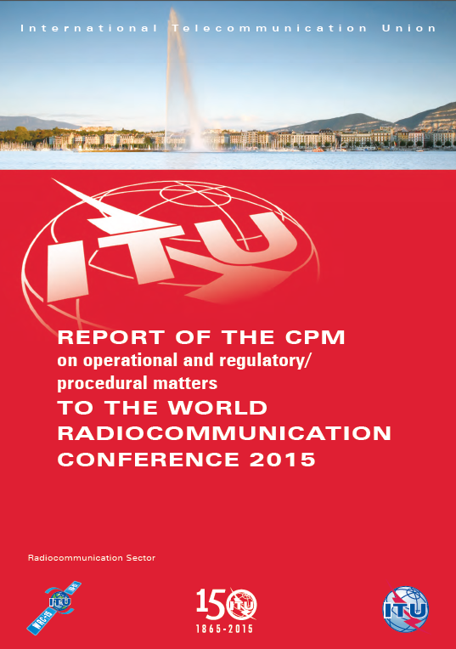

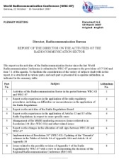


International Dimension
APT
Coordinated
Proposals
Proposals
ASMG
Informal
Group
(Structure
&
Chairmanship)
Member States
ATU
WRC-19
160 Member States
3400 Participants
CEPT
CPM Report
Conference
Secretariat
(BR & GS)
Agenda:
Draft WRC Res &
Final Council Decison
Director’s Report
RA-19
RCC

Slide 4
CEPT 5G Roadmap
B.
WRC-19
(>24 GHz)
A. Harmonization
C.
Verticals
D.
Other spectrum challenges
3.4-3.8 GHz
24.25-27.5 GHz
700 MHz
31.8-33.4 GHz
Other IMT bands
40.5-43.5 GHz
Licensing
Specifics
FS Backhaul
Needs
http://www.cept.org/Documents/ecc/35302/ecc-17-034-annex-05_roadmap-for-5g-march-2017

Slide 5
Food for thoughts
Interest in bands above 56 GHz ?
Worldwide development concentrate on 24.25-43.5 GHz
Fixed service links are often used by Mobile Operators itself
Satellite links are not flexible in terms of spectrum bands
Global spectrum harmonization is essential for economies of scale
Timely availability of spectrum is equally essential
Further national and/or regional decisions can be complementary.

Slide 6
Tuning range – opportunity for better harmonisation
The “tuning range” approach would allow adjacent bands to be supported by the same equipment
Will enable a large number of countries to benefit from the economies of scale and minimise the amount of bands within a terminal
Countries/Regions can allow usage in a portion of the “tuning range”
The “tuning range” approach is particularly relevant for 24.25-27.5 GHz and 40.5 – 43.5 GHz due to complementary developments in other regions in adjacent bands
.

Slide 7
WRC-19 Agenda item 1.13
“to consider identification of frequency bands for the future development of International Mobile Telecommunications (IMT), including possible additional allocations to the mobile service on a primary basis, in accordance with Resolution 233 (WRC-12);”
Resolution 238 resolves to invite ITU-R
2. To conduct and complete in time for WRC-19 the appropriate sharing and compatibility studies, taking into account the protection of services to which the band is allocated on a primary basis, for the frequency bands: […]

Slide 8
RES 238 (WRC-15) - THE LIST
Not on the list:
5 925 – 7 750 MHz
10.4 – 10.6 GHz
27.5 – 29.5 GHz
76 – 81 GHz
86 – 100 GHz
Identification | Additional allocation
24.25 – 27.5 GHz | 24.25 – 25.25 (R1/R2)
 | 31.8 – 33.4 GHz
37 – 40.5 GHz
 | 40.5 – 42.5 GHz
42.5 – 43.5 GHz
45.5 – 47 GHz
 | 47 – 47.2 GHz
47.2 – 50.2 GHz
50.4 – 52.6 GHz
66 – 76 GHz
81 – 86 GHz

Slide 9
Agenda Item 1.13 (approved by CPG19#3)
CEPT supports studies on IMT spectrum needs in the range 24.25-86 GHz and sharing and compatibility studies for the bands listed in Resolves 2 of Resolution 238 (24.25-27.5 GHz, 31.8-33.4 GHz, 37-43.5 GHz, 45.5-50.2 GHz, 50.4-52.6 GHz, 66-76 GHz and 81-86 GHz), with the focus on the frequency bands 24.25-27.5 GHz, 31.8-33.4 GHz and 40.5-43.5 GHz.
CEPT intends to harmonise the 24.25-27.5 GHz band for Europe for 5G before WRC-19 through the adoption of a harmonisation decision and to promote it for worldwide harmonisation. Hence the 24.25-27.5 GHz is a clear priority for immediate study within CEPT. Studies need to take into account the compatibility with and protection of all existing services, including their future deployments, in the same and adjacent frequency bands; in particular the protection of current and future EESS/SRS earth stations should be addressed.

Slide 10


Agenda Item 1.13 (approved by CPG19#3)
Preliminary CEPT position (continued):
CEPT supports the identification of global bands for IMT among the bands listed in resolves to invite ITU‑R 2 of Resolution 238, taking into account the results of sharing and compatibility studies with existing services. Bands outside those listed in resolves to invite ITU-R 2 of Resolution 238 are not supported for consideration under this Agenda item.
Note: CEPT has developed a roadmap on 5G (http://cept.org/ecc/topics/spectrum-for-wireless-broadband-5g#roadmap). In this respect it is noted that “Europe has harmonised the 27.5-29.5 GHz band for broadband satellite and is supportive of the worldwide use of this band for ESIM. This band is therefore not available for 5G”.
    CEPT Coordinator: Robert Cooper (G),
    coordination team: Vladislav Sorokin (RUS), Sarunas Oberauskas (LTU)

Slide 11
Issues and challenges
Need to ensure compatibility with existing uses in the same and/or adjacent bands
Protection of scientific and passive use
Difficulties and cost of clearing existing uses
Possibility to flexibly manage backhaul in the same bands? Fixed links in higher frequency bands will be required to support backhaul for future mobile networks including 5G/IMT2020.
Ensure future development of satellite systems.

Slide 12
Challenge: Overlap of bands ?
37.5-40.5
GHz
AI 1.14
HAPS
AI 1.5
ESIM
AI 1.13
IMT2020 /5G
AI 1.6
NGSO FSS
37-43 GHZ
AI 9.1.9
NGSO FSS
47-52 GHZ

Slide 13
Conclusions
WRC Agenda item 1.13 requires early agreements on commonalities to achieve a positive result at WRC-19.
All bands under AI 1.13 will be studied.
Good candidate bands for a common agreement are 24.5-27.5 GHz, 31.8-33.2 GHz, 40.5-43.5 GHz.
All regional organizations should commit themselves before WRC-19.
Consensus on initial 5G band(s) envisaged
Studies should focus on those bands with the highest likelihood of common implementation.
Overlap of bands is not an issue.

Slide 14

Thank you
Alexander Kühn
Chairman CEPT CPG19
Federal Network Agency
Tulpenfeld 4
53113 Bonn
Germany
221-CPG@bnetza.de
P +49 (228) 14 12 13
M +49 (173) 30 40 281
CPG page: http://www.cept.org/ecc/groups/ecc/cpg

